Slide 1
Chapter 12
Introduction to Oops

Slide 2
List of contents
Problems in Procedure oriented approach
Specialty of Python language
Features of Object oriented programming system
Class and object
Encapsulation
Abstraction
Inheritance
Polymorphism

Slide 3
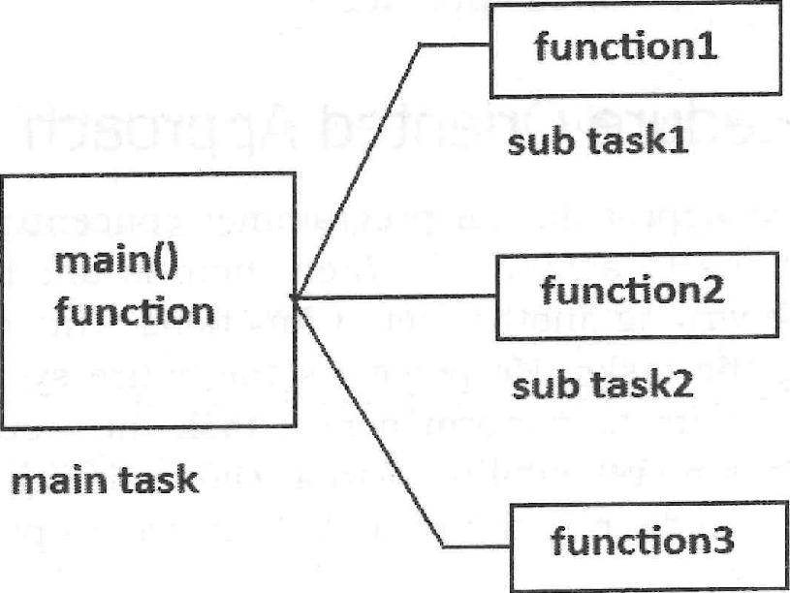
Introduction
The languages like C, Pascal, Fortran etc., are called Procedure Oriented Programming languages since in these languages, a programmer uses procedures or functions to perform a task.
While developing software, the main task is divided into several sub tasks and each sub task is represented as a procedure or function. The main task is thus composed of several procedures and functions. This approach is called Procedure oriented approach.

Slide 4
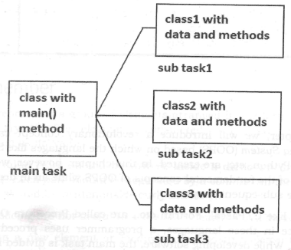
On the other hand, languages like C++, Java and Python use classes and objects in their programs and are called Object Oriented Programming languages. A class is a module which itself contains data and methods (functions) to achieve the task.
The main task is divided into several sub tasks, and these are represented as classes. Each class can perform several inter-related tasks for which several methods are written in a class. This approach is called Object Oriented approach.

Slide 5
Problems in Procedure oriented approach
Whenever developer wants to perform a new task, he would be writing a new set of functions. Thus there is no reusability of an already existing code. A new task every time requires developing the code from the scratch. This wastes programmer's time and effort.
In Procedure Oriented approach, every task and sub task is represented as a function and one function may depend on another function. Hence, an error in the software needs examination of all the functions. Thus debugging or removing errors will become difficult. Any updations to the software will also be difficult.
When the software is developed, naturally code size will also be increased. It has been observed in most of the software developed following the Procedure Oriented approach that when the code size exceeds 10,000 lines and before reaching 100,000 lines, suddenly at a particular point, the programmers start losing control on the code. This means, the programmers could not understand the exact behavior of the code and could neither debug it, nor extend it. This posed many problems, especially when the software was constructed to handle bigger and complex systems

Slide 6
There is another problem with Procedure Oriented approach. Programming in this approach is not developed from human being's life. Statements, functions or procedures never reflect the human beings (objects). So, from the ‘human beings' point of view, they are unnatural. Unnatural activities are difficult o perform.
Due to the preceding reasons, computer scientists felt the need of a new approach where programming will have several modules. Each module represents a 'class' and the classes can be reusable and hence maintenance of code will become easy. When there is an error, it is possible to debug only on that class where error occurred without disturbing the other classes. This approach is suitable not only to develop bigger and complex applications but also to manage them easily. Moreover, this approach is built from a single root concept 'object', which represents anything that physically exists in this world

Slide 7
Specialty of Python language
Python is an object oriented programming language like Java, it does not force the programmers to write programs in complete object oriented way.
Unlike Java, Python has a blend of both the object oriented and procedure oriented features. Hence, Python programmers can write programs using procedure oriented approach (like C) or object oriented approach (like Java) depending on their requirements.
This is definitely an advantage for Python programmers!

Slide 8
Features of Object oriented programming system
There are five important features related to Object Oriented Programming System. They are:
Classes and objects
Encapsulation
Abstraction
Inheritance
Polymorphism
Let's move further to have clear understanding of each of these features

Slide 9
Class and object
The entire OOPS methodology has been derived from a single root concept called 'object'.
An object is anything that really exists in the world and can be distinguished from others. This definition specifies that everything in this world is an object.
For example, a table, a ball, a car, a dog, a person, etc. will come under objects. Then what is not an object? If something does not really exist, then it is not an object. For example, our thoughts, imagination, plans, ideas etc. are not objects, because they do not physically exist
To understand a class, take a pen and paper and write down all the attributes and actions of any person. The paper contains the model that depicts a person, so it is called a class.
We can find a person with the name Raju', who got all the attributes and actions as written on the paper. So Raju' becomes an object of the class, Person. This gives a definition for the class. A class is a model or blueprint for creating objects. By following the class, one can create objects. So we can say, whatever is there in the class, will be seen in its objects also.

Slide 10
We can use a class as a model for creating objects. To write a class, we can write all the characteristics of objects which should follow the class. These characteristics will guid_{e} us to create objects. A class and its objects are almost the same with the difference that a class does not exist physically, while an object does.
Creating Classes and Objects in Python:
Let's create a class with the name Person for which Raju and Sita are objects. A class is created by using the keyword, class. A class describes the attributes and actions performed by its objects. So, we write the attributes (variables) and actions (functions) in the class as:
# This is a class
class Person:
# attributes means variables
name = ' Raju '
age = 20
# actions means functions
def talk(cls):
print(c1s . name)
print(cls . age)

Slide 11
Observe the preceding code. Person class has two variables and one function. The function that is written in the class is called method. When we want to use this class, we should create an object to the class as:
p1 = Person()
Here, p 1 is an object of Person class. Object represents memory to store the actual data. The memory needed to create p I object is provided by PVM. Observe the function (or method) in the class:
def talk(cls):
Here, 'cls' represents a default parameter that indicates the class. So, cls.name refers to class variable `Raju'. We can call the talk() method to display Raju's details as:
pl.talk()

Slide 12
Encapsulation
Encapsulation is a mechanism where the data (variables) and the code (methods) that act on the data will bind together.
For example, if we take a class, we write the variables and methods inside the class. Thus, class is binding them together. So class is an example for encapsulation.
The variables and methods of a class are called 'members' of the class.
All the members of a class are by default available outside the class. That means they are public by default. Public means available to other programs and classes.
Encapsulation in Python
Encapsulation is nothing but writing attributes (variables) and methods inside a class. The methods process the data available in the variables. Hence data and code are bundled up together in the class. For example, we can write a Student class with 'id' and 'name as attributes along with the display() method that displays this data. This Student class becomes an example for encapsulation.

Slide 13
# a class is an example for encapsulation
class Student:
# to declare and initialize the variables
def __init__(self):
self.id = 10
self.name = 'Raju'
# display students details
def display(self):
print(self.id)
print(self.name)
Observe the first method: def(self). This is called a special function since its name is starting and ending with two underscores. If a variable or method name starts and ends with two underscores, they are built-in variables or methods which are defined for a specific purpose. The programmer should not create any variable or method like them. It means we should not create variables or methods with two underscores before and after their names.
The purpose of the special method def __init__(self) is to declare and initialize the instance variables of a class. Instance variables are the variables whose copy is available in the object (or instance). The first parameter for this method is 'self' that represents the object (or instance) of the present class. So, self.id refers to the variable in the object. In the Student class, we have written another method by the name display() that displays the instance variables.

Slide 14
Abstraction
There may be a lot of data, a class contains and the user does not need the entire data. The user requires only some part of the available data. In this case, we can hide the unnecessary data from the user and expose only that data that is of interest to the user. This is called abstraction.
A good example for abstraction is a car. Any car will have some parts like engine, radiator, battery, mechanical and electrical equipment etc.
The advantage of abstraction is that every user will get his own view of the data according to his requirements and will not get confused with unnecessary data

Slide 15
Abstraction in Python
In languages like Java, we have keywords like private, protected and public to implement various levels of abstraction. These keywords are called access specifiers. In Python, such words are not available.
In general, everything written in the class will come under public
Suppose, we do not want to make a variable available outside the class we can write the variable with two underscores before it as shown below
class Myclass:
# this is constructor.
def __init__(self):
self. __y = 3 # this is private variable
Now, it is not possible to access the variable from within the class or out of the class as:
m = Myclass()
print(m.__y) # error

Slide 16
Even though, we cannot access the private variable in this way, it is possible to access it in the format:
instancename._Classname__var
That means we are using Classname differently to access the private variable. This is called name mangling
print(m._Myclass__y) # display private variable y
Go to Jupyter notebook for example

Slide 17
Inheritance
Creating new classes from existing classes, so that the new classes will acquire all the features of the existing classes is called Inheritance.
A good example for Inheritance in nature is parents producing the children and children inheriting the qualities of the parents.
There are three advantages of inheritance.
First, we can create more useful classes needed by the application (software).
Next, the process of creating the new classes is very easy, since they are built upon already existing classes.
The last, but very important advantage is managing the code becomes easy, since the programmer creates several classes in a hierarchical manner, and segregates the code into several modules

Slide 18
An Example for Inheritance in Python
Here, we take a class A with two variables 'a' and 'b' and a method, method 1(). Since all these members are needed by another class B, we extend class B from A. We want some additional members in B, for example a variable 'c' and a method, method2(). So, these are written in B. Now remember, class B can use all the members of both A and B. This means the variables 'and also the methods methodl 0 and method2() are available to class B. That means all the members of A are inherited by B
Go to Jupyter notebook for example

Slide 19
Polymorphism
The word Polymorphism' came from two Greek words 'poly' meaning 'many' and `morphos' meaning 'forms'. Thus, polymorphism represents the ability to assume several different forms.
In programming, if an object or method is exhibiting different behavior in different contexts, then it is called polymorphic nature.
Polymorphism provides flexibility in writing programs in such a way that the programmer uses same method call to perform different operations depending on the requirement.
Go to Jupyter notebook for example

